Slide 1

Enterprise Data & Analytics Strategy Council
Proposed
Terms of Reference

Slide 2
Data & Analytics (D&A) Strategy Governance
What for:
Who by:
Enterprise Strategic Alignment, Budget, Resources, Approval of Data & Analytics Strategy
Top Down
Enterprise Strategic Direction
Executive Data & Analytics Strategy Committee
Vision for Data & Analytics at NG
Link to Business Strategy
Governs NG investment
Executive Sponsors
Heads of Data (Group, GF, BU)
Enterprise Strategic Implementation
Creates Enterprise Data & Analytics Strategy, Roadmap, Policies Methodology & Standards
Strategy to achieve Vision
Aligns Group & BU priorities
Governs Enterprise requirements
Heads of Data
Data Domain Owners
Group Stakeholders (Digital, Arch)
Enterprise D&A Strategy Council
D&A
Strategy
Data Governance
Across
Bottom Up
Entity D&A Strategy Council: BU Strategy to achieve BU Vision
Data Delivery Board: Sets a common delivery method for data and analytics, incorporating strategic direction and guardrails
Data Domain Board: Understandability, Trust, Security of data domain
Entity D&A Strategy Council: Head of Data, Data Governance, Data Architects, Analytics & AI
Data Delivery Board: Grp Data Engineering, Heads of Data
Data Domain Board: Data Domain Owner, Stewards, SMEs
Entity Implementation
Domain, Budget, Resources, Roadmap, Sub-Policy & Standardization
Entity D&A
Strategy Council
Data Delivery Board
Data Domain Board
Operational
Projects: Delivery of data products and/or analytics products. In line with direction from above
Working Groups: Initiated by any board or council to rectify issues or improve capabilities
Projects: Head of Data, Grp Data Engineering
Working Groups: It depends
Operationalize DM & Projects
Data & Analytics Projects
Working Groups

Slide 3
Enterprise Data & Analytics Strategy Council - Terms of Reference
Purpose of Council (to be agreed at first meeting)
Data Council Members
The core purpose of the Council is to own and govern the NG Enterprise Data & Analytics Strategy which should be determined by an alignment of Group and Entity business strategy drivers. The Council will steer and approve Enterprise (cross-entity) Data & Analytics decisions.
Heads of Data
Group – Dan Robertson (chair)
US Gas – Nick Raad
US Electric – Preston Large
UK Electricity – Keith Trilloe - tbc
US Customer - Alex Kanashiro
UK ESO - Niall Branley
Global HR - Gary Dionne (Mike Ives)
Group Data Office
Data Governance – Kam Bharj
Data & Analytics Architecture –Nishit Ajwaliya
Information Models – Maria Saiz
Data Platforms & Engineering – Bharat Tripathi
Group Data Strategy – Bronwynne Stoddart
Consider extending once ToR established?:
Heads of Data (Global Functions) –
Finance-US - Phil Kluko
Finance-UK - Stuart Tomkinson
Global Vendor - Scott Rodgers
Enterprise Architecture – Keith Vargas
Enterprise responsibilities (Global):
Group and BU D&A Strategies and Operating Model alignment
NG Enterprise Data Domains, Data Models, Ref Data
Enterprise Operating Model (common P/P/T/D)
Enterprise Data Reference Architecture
Shared external data sets
Common processes, eg Data Catalogue
Agree funding model for Group Investments
BMS Data Management Standards and Framework
NG Data Risk – Data Management
Data project alignment (in line with above)
Agenda
Inputs/Outputs
Frequency & Duration
Strategy Updates
Data Model approvals (cross BU)
Escalations from Entity DDBs
Inform of Data project scope
Enterprise D&A Architecture approvals
BMS Data Management updates
AOB
Data Strategy updates from BU & Grp
Grp – Tool selections, Enterprise Model, Process updates etc
BU/Global functions – new data projects (significant)
Every other month
1.5-hour duration
Off-line working groups for any urgent cross BU decisions

Slide 4
Proposed agenda for first meeting
October 2021 –
Global Governance Council : Data & Analytics

Slide 5
Enterprise D&A Strategy Council (ED&A SC) | October 2021 - Agenda
Item # | Item | Item owner | Description | For Decision or Information
1 | Approve ToR | Dan Robertson | Proposed ToR has been shared in advance. Owner is looking for agreement in principle, recognising that the ToR will evolve as NG data strategy and operating models mature | Decision
 | Strategy updates | (any – to be informed in advance)
 | DDB escalations | (any – to be informed in advance)
 | Data Project Scope | (any to be informed in advance) | Details of Strategic Data Projects to be shared in advance at the ED&A SC for efficiency/synergy/reuse/overlap/duplication/dependency awareness | Information
 | Enterprise Data Model | Maria Saiz | Owner is looking for agreement from the ED&A SC that BUs/GFs will by default align with the Enterprise Data Model and any exceptions will run through working groups and come to the ED&A SC for approval | Decision
 | Enterprise Data Catalogue | Kam/Diane | Owner is looking for agreement from the ED&A SC that BUs/GFs will by default align with the Enterprise Data Catalogue and any exceptions will run through working groups and come to the ED&A SC for approval | Decision
 | AOB
 | Summarise decisions and actions | Dan Robertson | Confirm decisions and actions

Slide 6
Decision Log
Decision# | Decision | Detail | Meeting date (update)

Slide 7
Global Data Governance Council - Terms of Reference
IT Data Attendees
Business Data Attendees
Purpose of Council
Head of Group Data and Analytics – Dan Robertson
Data Governance (Chair) – Dan Senter
Information Architecture – Bryan Connolly
Data Engineering – Bharat Tripathi
Analytics Enablement – Tom Towne
Information Management & Data Privacy – Deborah Tamborski / Glen Truman
Finance Data Domain Leads –
Global - tbc
US - Phil Kluko
UK - Stuart Tomkinson
Customer Data Domain Leads
US - Alex Kanashiro
UK – Andrew Burns
Workforce Data Domain Lead
Global - Gary Dionne (Dave Smith)
Asset Data Domain Leads
US Gas – Nick Raad
UK Gas – Jacob Isherwood (Dan Langan)
US Electric – Preston Large
UK Electricity – James Dowding
US Transmission – TBC
Vendor Data Domain Lead
Global - Scott Rodgers
Energy Procurement Data Domain Lead – Terrence Kain
US Generation Data Domain Lead – Dragan Kolanovic
UK Electricity Balancing Data Domain Lead – Paul Wilson
Land/Property Data Domain Lead – Rukshana Yousuf
To lead Data across the company –
Cross-functional data leadership team to provide day to day direction and agree value cases for access to funding to build
Data Trust : Our data is accurate, timely, of high quality, and supported by the right skills and governance to manage it
Data Centricity : Our data is underpinned by enterprise tools and organised for current and future business needs
Data Insights : Our data is presented within context, giving meaning and relevance to deliver value
Review and approve domain level strategies, endorse standards / policy changes and report progress on data maturity, quality and benefits realisation
To report to the Executive Board on data compliance, data maturity, data quality and risk / issues
Agenda
Decisions to be made
Frequency & Duration
Minutes from the previous meeting
DG Programme Updates / BMS Compliance
Data Domain Status
Maturity / Data Quality / Value Creation
Decisions / Issues Resolution / Risk Review
AOB
Updates to strategy
Recommendations on policy / standard changes
Mitigations of domain risks
Approval of master data domain use
Establish / eliminate data communities of practice
Company-wide communications
Every other month
1.5-hour duration
* Any in () are delegates
Notes:
DS
JG – This is your forum to drive the agenda and move forwards collectively… Work on the cross dependencies across other domains

Slide 8
Global Governance Council (GGC) for Data & Analytics (D&A) – in context
What are the touchpoints across NG?
Grp Exec D&A Sponsors
BU Exec D&A Sponsors
Sponsors Enterprise funding and sets Group direction (Grp Vision/Strategy)
Sponsors BU funding and sets BU direction (BU Vision / Strategy)
GGC for D&A
Data Office takes direction from GGC and provides progress updates
Grp Data Office
Strategy alignment and Group priority setting
DGC ToR setting and Cross BU DG arbitration
BU/GF Data Office
BU/GF/Domain DGC
Key:
Proposed
ITGC
Digital Technology Strategy alignment
Not in place but required
DGC working groups
TTF
Existing

Slide 9
Data Management & Data Governance
Diane LoPreste

Slide 10
Data Management & Governance Tactical Level
Enterprise Strategic Alignment, Budget, Resources, Approval of Data Strategy, Strategic Projects
Top Down
Strategic
Executive Data Governance Committee
CDO & C Suite Executive Sponsors aligned to Domain Owners
Creates Enterprise Data Strategy, Roadmap, Policies Methodology & Standards
Strategic Implementation
Data Governance Council
Across
Bottom Up
Domain, Budget, Resources, Roadmap, Sub-Policy & Standardization
Tactical
Domain Boards
Domain Owners, Stewards and Technical Custodians
Ensures data is well Managed, Trusted, secure, reliable and of high quality within their domain
Oversight and management of domain data, including data definitions, sourcing, usage, standards and DQ thresholds
Membership is owners, stewards, technical custodians, SME’s
The domain boards meet monthly, chaired by business owner with agenda dictated by prioritized data issues and support for Domain strategic initiatives
Operational
Working Groups / Projects
Operationalize DM / Projects
Enterprise & Domain DM/DG Leads, Owners must operate at Tactical Level

Slide 11
Data Management & Governance Strategic & Strategic Implementation Level (We Need Focus Here)
Executive Data Governance Committee
Sponsors representing domains across the organization
Empowered to approve, fund, prioritize and recommend strategic projects to address data and business needs
Review and approve data strategy, strategic roadmap, and policies for the program
Final Arbiter of all disputes and conflicts
Hold the Data Governance Council accountable for specific and timely outcomes
Develop appropriate data communications with other governing bodies and stakeholders
Enterprise Strategic Alignment, Budget, Resources, Approval of Data Strategy, Strategic Projects
Top Down
Strategic
Executive Data Governance Committee
Enterprise Data Strategy, Roadmap, Policy, Methodology & Standards
Strategic Implementation
Data Governance Council
Across
Data Governance Council
Owners, stakeholders, SME’s representing Domains across the organization
Helps set and implement direction, strategies and priorities
Make data decisions raised by the boards and working groups
Approve remediation plans and make cross functional decisions
Reports to Executive Steering Committee
Bottom Up
Domain, Budget, Resources, Roadmap, Sub-Policy & Standardization
Tactical
Domain Boards
Operational
Working Groups / Projects
Operationalize DM / Projects
Reduce redundancy and increase efficiency;
Move towards a single version of the truth by driving data decisions
Enterprise & Domain DM/DG Leads, Owners must operate across the organization

Slide 12
Data Management & Governance Strategic & Strategic Implementation Level (We Need Focus Here)
Enterprise Strategic Alignment, Budget, Resources, Approval of Data Strategy, Strategic Projects
Top Down
Strategic
Executive Data Governance Committee
Enterprise Data Strategy, Roadmap, Policy, Methodology & Standards
Strategic Implementation
Data Governance Council
Data Governance Office
Staffed with dedicated resources
Direct Data Management & Data Governance Efforts
Reports Enterprise Data Governance program status with focus on progress and DQ improvement
Build awareness on Data Governance and Data Management best practices
Report relationship is to the Executive Steering Committee with a dotted line to the data governance council
Across
Bottom Up
Domain, Budget, Resources, Roadmap, Sub-Policy & Standardization
Tactical
Domain Boards
Operational
Working Groups / Projects
Operationalize DM / Projects
Enterprise & Domain DM/DG Leads, Owners must operate across the organization

Slide 13
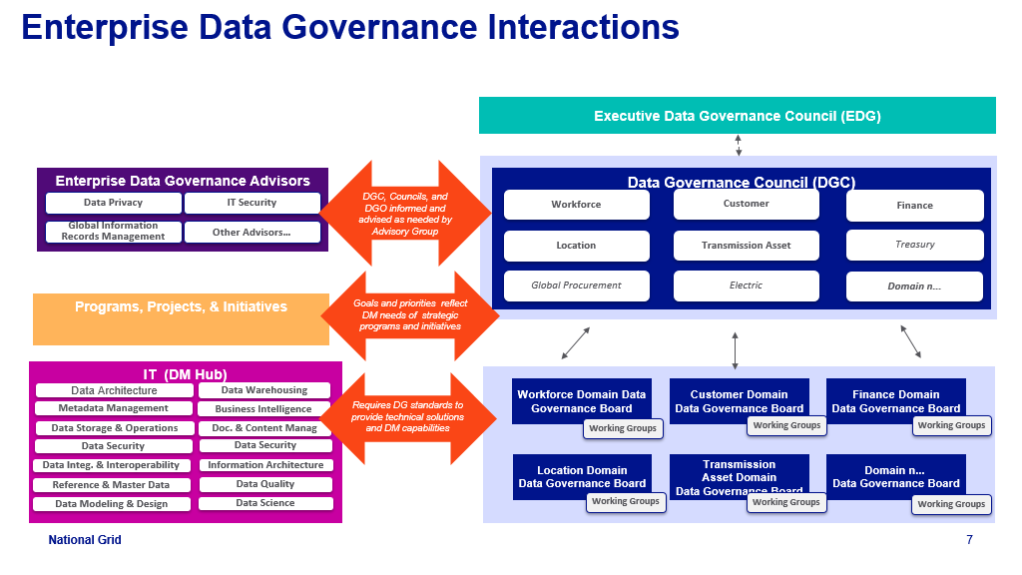
Enterprise Data Governance & Data Management Interactions (Draft)
Data Governance
Team
Security
GIRM
Information Architecture
Other Advisors…

Slide 14
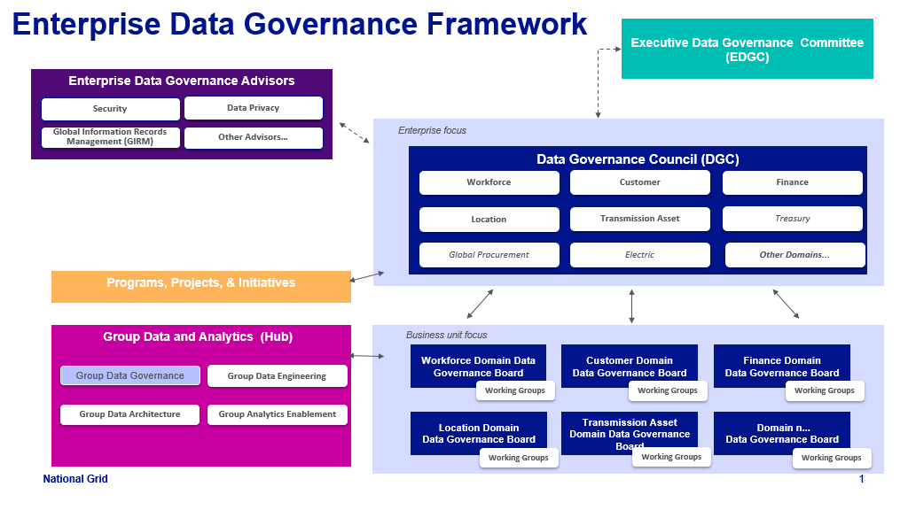
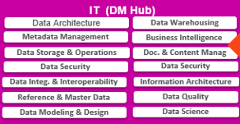
Enterprise Data Governance Operating Model (Draft)
Data Governance
Team
Privacy & Security
GIRM
Strategic
Information Architecture
Advisor…
Strategic
Implementation
Data Management
Team
Tactical & Operational

Slide 15
Enterprise Data Governance Organizational Components
Executive Data Governance Committee
Sponsors representing domains across the organization
Empowered to approve, fund, prioritize and recommend strategic projects to address data and business needs
Review and approve data strategy, strategic roadmap, and policies for the program
Final Arbiter of all disputes and conflicts
Hold the Data Governance Council accountable for specific and timely outcomes
Develop appropriate data communications with other governing bodies and stakeholders
Data Governance Council
Owners, stakeholders, SME’s representing Domains across the organization
Helps set and implement direction, strategies and priorities
Make data decisions raised by the boards and working groups
Approve remediation plans and make cross functional decisions
Reports to Executive Steering Committee
Executive Steering Committee
Data Governance Office
Enterprise Data Governance Council
Workforce
Customer
Finance
Location
Transmission Asset
Treasury
Domain Data Governance Board
Ensures data is well managed, trusted, secure, reliable and of high quality within their domain
Oversight and management of domain data, including data definitions, sourcing, usage, standards and DQ thresholds
Membership is owners, stewards, technical custodians, SME’s
The domain boards meet monthly, chaired by business owner with agenda dictated by prioritized data issues and support for Domain strategic initiatives
Global Procurement
Electric
Council …..
Data Governance Office
Staffed with dedicated resources
Direct Data Governance Efforts
Reports Enterprise Data Governance program status with focus on progress and DQ improvement
Build awareness on Data Governance and Data Management best practices
Report relationship is to the Executive Steering Committee with a dotted line to the data governance council
Domain Data Governance Boards
Workforce
Customer
Finance
Location
Transmission Asset
Treasury
Global Procurement
Electric
Board …..
Working Group(s)
Perform data analysis, provide data domain expertise, and make recommendation to its board
Packages cross functional issues with analysis, decision(s) required with recommendation
Working Group 1
Working Group 2
Working Group 3
Working Group …

Slide 16
NA - I believe we should add data architecture and design. I believe it should be both enterprise and BU responsibility. [updated to Ref Arch]
Some clarify needed on “proposed” and “Not in place but required”. For me GGC is also not in place but we kind of saying it is required. [to discuss]
KB - We should combines the two responsibility sections into one, to ensure we’re driving key decisions and approvals through this forum going forward [meant to be differentiating between global and multiple (but not all) BU]
The Global Workforce should be included under Heads of Data initially as this is inflight at the moment [done]
Do we need a standing agenda item for any data or tooling escalation? [ITGC should do this – created a link on diagram]
MS - 3 levels of governing bodies are usually needed. The usually are as follows:
Executive Enterprise DG board that includes domain sponsors (domain CEO & CIO) as members along with CDO. They make final decisions about funding, prioritization, and strategic initiatives. This seems to be missing. [this is in the link to Group Exec Sponsors]
Enterprise DG council domain owners and stakeholders along with SMES. They are implementing the overall strategic initiatives decided by the Executive board. This seems to be the Data Council outlined in the slide. We can start here but they are not the final decision makers which will slow down decision making and cross-functional cooperation. [the aim is to expand the scope over time and to start with something pragmatic to gather momentum from]
Domain DG boards which have day to day stewardship and tactical implementation. The work with the business operational teams that run the business day to day. These seems to be missing. [BU DGCs are still on here]
Work groups – operational groups not part of the DG governing bodies above which identify issues and cross-functional data need that need to be resolved or escalated. I can’t determine if we have these or not. [included on slide – are these in place?]
Enterprise responsibilities – I would add the following:
Enterprise Data Domains, Enterprise Conceptual Model, and Enterprise Logical Models. [added]
Enterprise Reference Data – this is the cross-functional reference data used by multiple domains. We have no clarity or ownership on such reference data today and it’s used broadly across NG. It may not have a domain owner because of its broad use.[added]
Enterprise DG also belongs here as we need that enterprise program view.[included in DM, Ref Data etc]
What is the difference between Enterprise and cross-BU responsibilities? I’m not sure this is clear. [added some clarity]
Agenda – what is AOB? This should also include cross-functional and reference data issue resolution that can not be settled (and thus escalated to them) by the Domain DG boards.[added]
Inputs/Outputs – [tbc]
What is a significant data project? [something architecturally significant (data, tech, process – new or major change)]
We should add something about escalated data issues from the Domain DG boards. There will likely be more of these at the beginning and fewer as the process becomes established. And the relevant recommendations the Executive Enterprise DG board.[done]
Frequency – The off-line work groups should be on-going and that expectation should be set initially. [ok]
Members –
I would include the Global Functions from the beginning as they have data used by all operational areas. And a lot of reference data too. They will undoubtedly be pulled into the discussions regardless. [will include HR and see how we go, the GF data leaders are not as data savvy, so want to get the structure right first]
What about the regulatory and legal areas which are not included here? They also have cross-functional data used by other functions.[to consider at a later date]
It’s missing Diane in the DG office.
PS – my name is misspelled.
The 3rd slide I find confusing and not sure what it’s trying to say. [will consider how to improve – it is trying to highlight the interdendencies with other forums of authority]

Slide 17
DL- 3 Governing bodies will be needed [I think the purpose is covered – we can discuss]
Enterprise Charter and how to determine criticality - prioritization and package pain points to be presented at meeting [I’m keen to get this going with some current issues/pain points and finesse as we go]
Chairs need to be established for each Governing Body [agreed]
Executive Group at CDO & C-Suite Level - Sponsors representing domains across the organization Empowered to approve, fund, prioritize and recommend strategic projects to address data and business needs. Review and approve data strategy, strategic roadmap, and policies for the program and final arbiter of all cross functional disputes and conflicts. Approves Strategic Initiatives, budget and Resources. [agreed – some of this is covered, some we need to build to and help the Business recognize the importance of this]
Data Governance Council - Owners, stakeholders, SME’s representing Domains across the organization, Helps set and implement direction, strategies and priorities, Make data decisions raised by the boards and working groups, Approve remediation plans and make cross functional decisions, Reports to Executive Steering Committee [intention is for this board to ultimately pick this up]
Data Governance Boards - Ensures data is well managed, trusted, secure, reliable and of high quality within their domain, Oversight and management of domain data, including data definitions, sourcing, usage, standards and DQ thresholds, Membership is owners, stewards, technical custodians, SME’s, The domain boards meet monthly, chaired by business owner with agenda dictated by prioritized data issues and support for Domain strategic initiatives [next level down]
Working Groups - Perform data analysis, provide data domain expertise, and make recommendation to its board, Packages cross functional issues with analysis, decision(s) required with recommendation [level below – all shown on the ‘in context’ slide]
Creation of advisor board or align other cross functional groups as required to participate in meetings [to discuss]
Alignment of Data Governing Bodies to Project & Initiatives [need to show on ‘in context’]
Alignment of Data Governing Bodies to IT Enablement & PMO (project intake and prioritization) [need to show this on in context]
Standing agenda and minutes covering people, process, technology and data; Having the right delegates are fine but owner will always be accountable; Agenda needs to be established and agreed prior to meeting by each chair; Having Structure -- Enterprise Charter, Meeting Minutes, Voting Mechanism; Program Onboarding Process and KPI’s, Proper Pain Point Identification, Escalation and Remediation and Data Propagation Process etc. to help build and hold momentum and accountability at all levels [agreed]
I do not thing we have the right people at the Global head of Data (and functions) Level [let’s discuss]
Also am I still in the Data Governance Office? [this is now a broader strategy council, you should still be involved when DG is on the agenda or play a lead role in the DGBs]

